Slide 1
Use of BAS to Identify Inefficient Operations
Prepared by Garrett Mosiman and Patrick Smith, Center for Sustainable Building Research, University of Minnesota
Project in coordination with John Marshall, Engineering and Energy Management Division Manager, Hennepin County Facility Services
Project funding provided by the Hennepin University Partnership
2017

Slide 2
Purpose and scope of project
A majority of existing buildings waste energy
10-20% of whole building energy savings attributed to waste typically
Buildings can waste energy without causing discomfort or announcing improper operation
Building automation systems (BAS) can offer detailed information on building operation
Monitoring-based commissioning (MBCx) can be effective, though costly to set up and operate
Sufficient preventative maintenance to ensure no operating inefficiencies is unlikely to be achieved
The amount of information available in BAS creates a need for identification and execution of simple, high-priority checks
Some issues come up more often than others

Slide 3
Project overview - tasks
Select buildings for pilot
Identify systems to monitor on each pilot project
Identify malfunctions or sub-optimal operation in identified systems
Estimate energy and cost implication of malfunction or sub-optimal operation
Evaluate malfunctions or sub-optimal operation to:
Remedy issues identified
Develop checks to implement to identify subsequent occurrences
Implement policies to operationalize the above

Slide 4
Building 1: Health Services Building
12-story, 220,000 square foot building
Contains County offices and a clinic.
Built in 1989, recommissioned in 2013, several energy conservation opportunities identified.
The 12 air handlers were sufficiently similar to enabled comparisons to be made and for outliers to be seen by comparison across floors.

Slide 5
Building 1: Health Services Building
Air Handling System selected for monitoring:
15 air-handling units
11 of which are identical units, each serving one floor.
1 additional large unit located in the basement serves that floor as well as the first floor
Distributed to VAV boxes
Most do not contain reheat
Fin tube radiation
Only source of heating when unoccupied

Slide 6
Issues noted
Leaking steam valves in air handler heating coils when unoccupied
Economizer malfunction

Slide 7
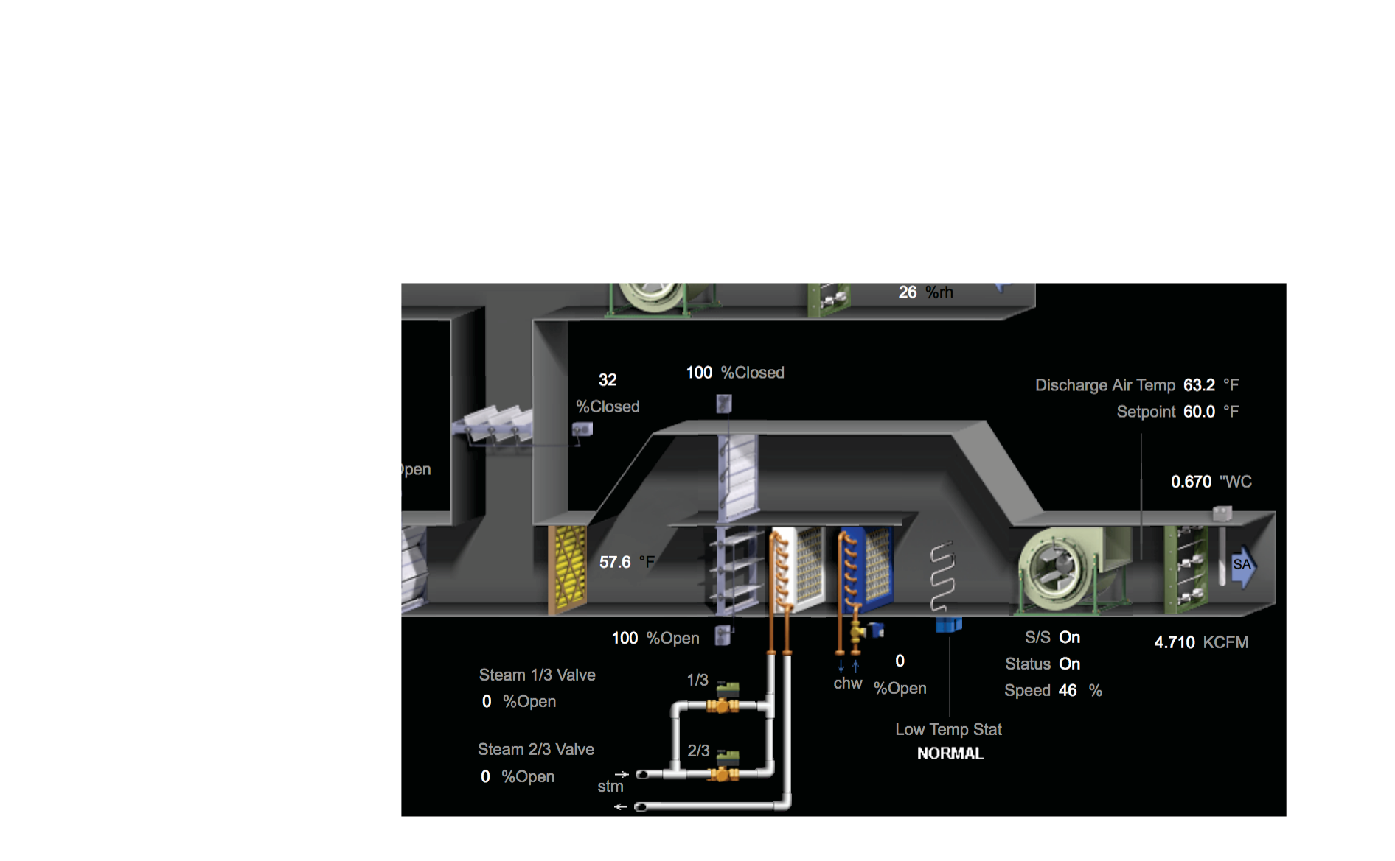
Steam valves leaking when closed
AHU-3, 3-7-2017, 10:14pm
dt= 82.4 - 73.7 = 8.7
so
q=10,523.5 Btu/hr
AHU-11, 3-22-2017, 1:50pm
dt= 63.2 - 58.6 = 4.6
so
q=23,399.3 Btu/hr

Slide 8
Steam valves leaking when closed
Assumed average loss rate of 16,000 Btu/hr per AHU
4,484 hours of potential losses
72mmBtu average per AHU
502mmBtu estimated for all 7 instances
Cost estimated at $841 per AHU, 5,889 for all instances.

Slide 9
Recommended actions:
Steam leaks that appear as elevated MAT when AHU fans are off may or may not be substantial enough to justify further action. Recommend identifying suspect valves via nighttime MAT, then verifying energy waste magnitude while AHU is running and heating valves are reporting 0% open. Check shortly after the steam system is activated in the fall, in the middle of the heating season, and shortly before the steam system is deactivated in the spring.

Slide 10
Malfunctioning Economizer
Comparison from sensor outputs to weather data:
Outside Air Temperature:
Actual =66°F
Reported to BAS = 66°F
Relative Humidity:
Actual RH = 50%
Reported in BAS = 62.6%
AHUs 3, 11, and 12 were not economizing, all others were. Similar return air RH on all units, may be due to a single malfunctioning sensor
5/25/17

Slide 11
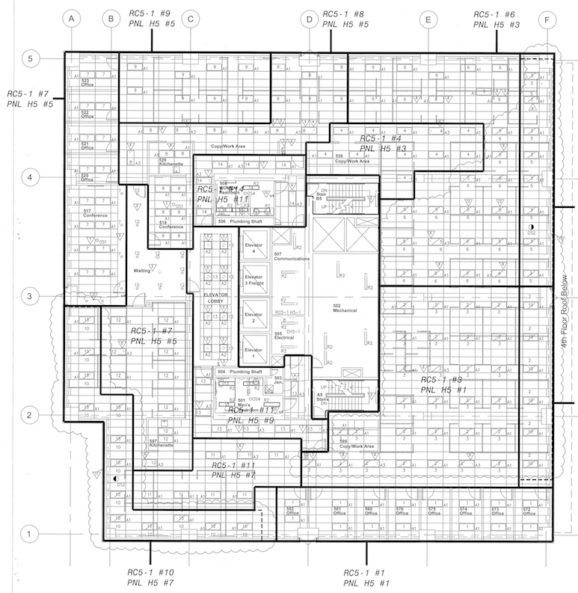
Potential lighting controller failure
Fails “on.”
Average 8.5 kW of lighting connected to automated controllers, periodic failure to turn off.
14 hours / day unoccupied = 119 kWh per day in excess energy use.
3,570 kWh per month,
$357 per floor as worst-case

Slide 12
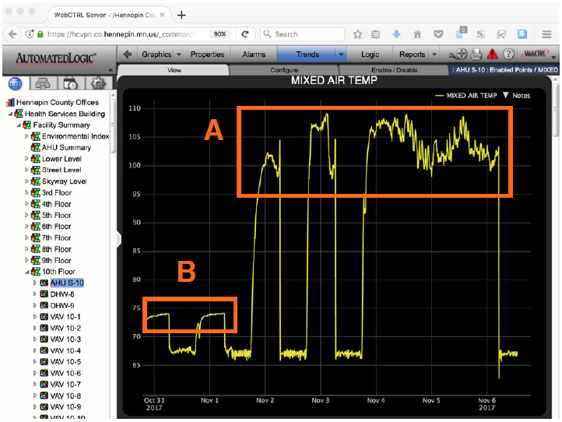
Recommended checks - HSB
AHU Schedules (all large air handlers)
Verify Timer Control (verify that AHU goes “off.” Done with trend log for a week).
Mixed Air Temp
Office lighting controller check (verify that lights sweep off correctly)
Steam valve leak check (done with trends)

Slide 13
Building 2: Hopkins Library
1-story, 12,500 square foot building
Public library, public meeting room, and library offices.
Built in 1967, renovated in 2001.
The renovation upgraded the mechanical and lighting systems
A new condensing boiler in 2007.
Hennepin county has many libraries, some with similar systems.

Slide 14
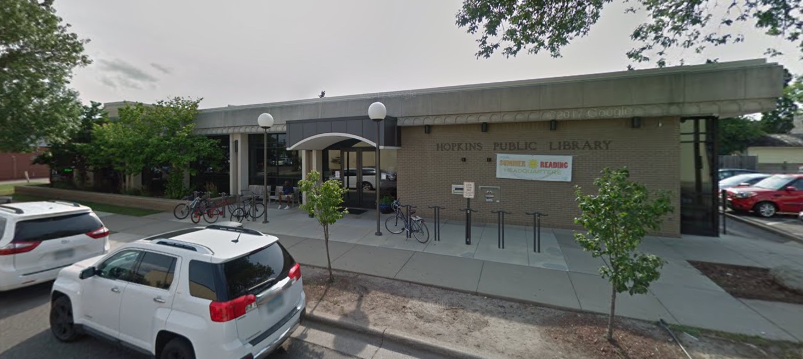
Building 2: Hopkins Library
Air Handling System and boiler system selected for monitoring:
1 air handling unit
Distributed to VAV boxes
1 Condensing boiler supplies heat to AHU heating coil and VAV reheats

Slide 15
Issues noted
Economizer malfunction
Excessive boiler return water temperature / excessive boiler runtime

Slide 16
Malfunctioning Economizer
Economizer disabled by malfunctioning or miscalibrated outdoor RH sensor.
Sensor reads 65.3%, airport weather station reports 30%.
5/11/17

Slide 17
Malfunctioning Economizer
Actual OAT = 64°F
Actual RH = 50%
5/25/17
Actual OAT = 65°F
Actual RH = 42%
5/31/17

Slide 18
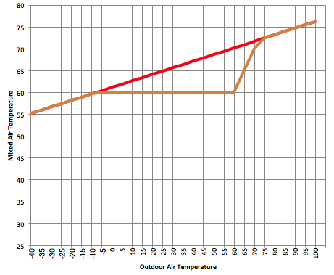
Malfunctioning Economizer
Energy Impact:
During spring 2017, economizer was never observed to work—dampers stayed at minimum position and air was cooled to meet DAT setpoint.
Cooling energy penalty calculated from Typical Meteorological Year weather file, excessive cooling required when building is occupied and outdoor air conditions are appropriate for economizing.
Graph at right shows MAT with economizing (orange line) and MAT at minimum damper position (red line). The area between the lines represents unnecessary cooling energy.
Calculated energy penalty per year:
227mmBtu
$2065 unnecessary electricity cost
Energy impacts are greater with reduced baseline ventilation ($500 / 5%) and with reduced DAT setpoint.

Slide 19
Excessive boiler return water temperature / excessive boiler runtime
Boiler runs before air handler is enabled (enabled by OAT only). Boiler does not serve fin-tube or other passive heating elements, so excessive runtime contributes very little to space temperatures. Likely shortens boiler / pump lifespan, may not contribute to significant energy waste.
Also note that return water temp is often above the range required for condensing.
5/18/17

Slide 20
Excessive boiler return water temperature / excessive boiler runtime
Recommended actions:
Set boiler to operate only when air handler is enabled.
For high Loop Return Temp:
A lower supply temp is recommended, but will likely result in additional comfort problems in perimeter zones served by VAV-1 and VAV-2.
Consider capital improvements (larger hydronic coils at VAV-2, supplemental heating for the cold zone, etc).
5/18/17

Slide 21
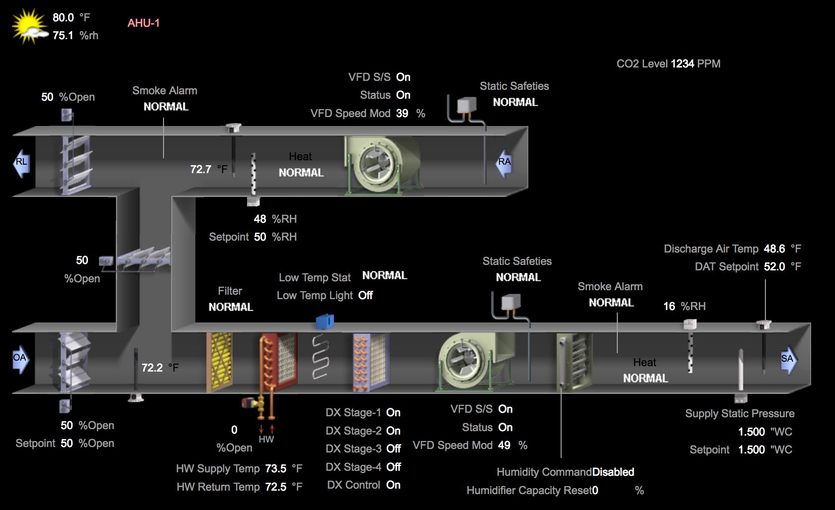
Additional Issue: Temperature Sensor Miscalibration
.
Miscalibration likely on the MAT sensor. Demand Controlled Ventilation sequence observed, which opened outdoor air dampers, but MAT is lower than RAT. MAT continued to report 72.2, even as outdoor air dampers modulated to 100% open position (OAT=80.0)
Recommended actions:
Consider a regular schedule for temp sensor recalibration / replacement.
7/18/17

Slide 22
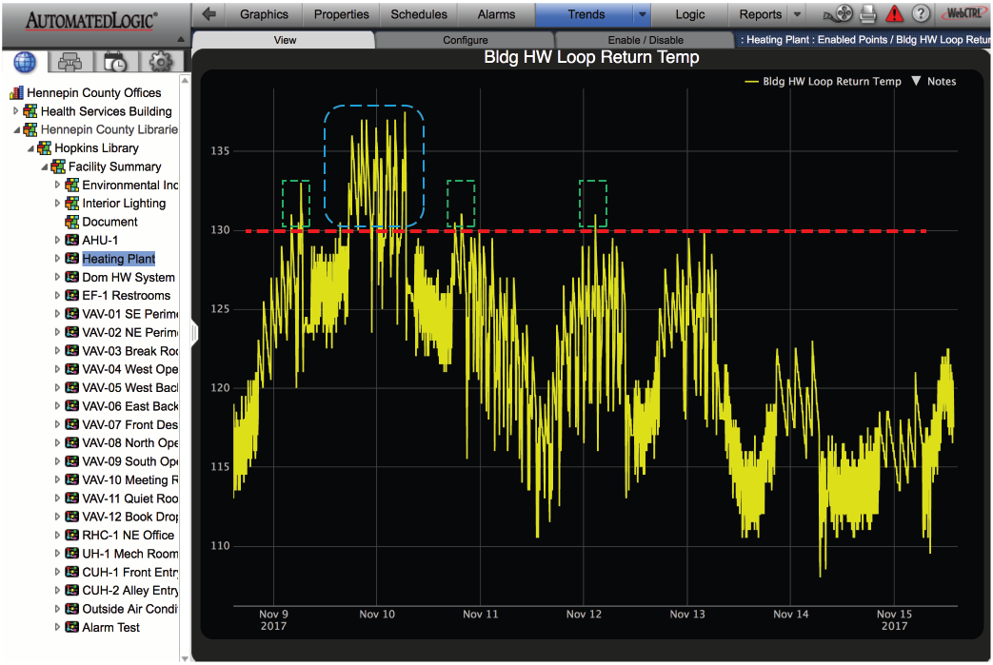
Recommended Checks: Hopkins Library
AHU Schedules
Verify timer control
Mixed Air Temp (faulty enthalpy control noted on this unit)
Check return water temp in range for condensing

Slide 23
Conclusions: Recommendations not related to a specific building
Save trend data for one year. In several cases operation was observed in the fall / winter of 2017 that appeared to differ from operation observed in the spring. Because only a month’s worth of trend data were available and the number of data points is large, it was not possible to confirm some changes. This longer-term trend data would also be useful in any future retrocommissioning process.
Develop a process that allows operations staff time to monitor system optimization. Typical monitoring process catches some sub-optimal operations but is typically focused on ensuring that the space conditioning is within established parameters.
Develop follow-up checks for systems that have previously contributed to sub-optimal operation and which have a high likely rate of failure, or which commonly malfunction.

Slide 24
Conclusions (continued)
Enthalpy control of economizing has malfunctioned in both buildings due to sensor miscalibration / failure. The MAT check will identify such malfunctions, but if they are to be prevented then a routine sensor calibration task should be started. The other viable option is to disable enthalpy control, relying only on sensible criteria for economizing.

